Slide 1

Employee Retention and Performance Analysis
This presentation explores key drivers of employee satisfaction and retention, analyzing data to uncover actionable insights.
by Prince Dubey, Radhika Natarajan and Akkalesh S P

Slide 2

Objectives
1
Understand Key Drivers
2
Analyze Department Trends
Identify factors influencing employee satisfaction, performance, and decisions to leave.
Identify satisfaction and performance trends across departments.
3
Assess Impact of Workload
4
Explore Role of Promotions
Assess the impact of workload, tenure, and salary on employee retention.
Explore the role of promotions and workplace incidents on quitting decisions.

Slide 3
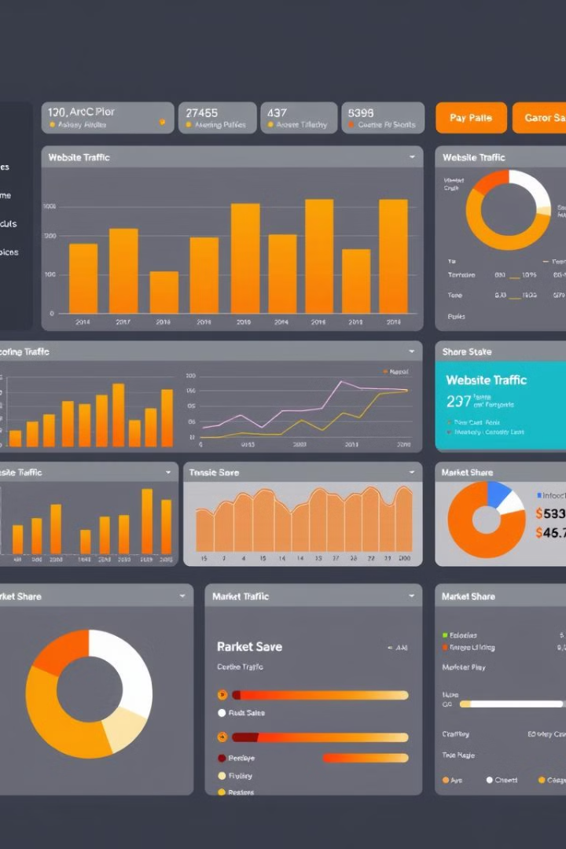
Dataset Overview
Variable
Description
satisfaction_level
Employee satisfaction (0–1 scale)
last_evaluation
Performance evaluation score
number_project
Number of projects handled
average_monthly_hours
Average monthly working hours
time_spend_company
Years spent at the company
Work_accident
Count of workplace accidents
Quit_the_Company
Whether the employee quit (Yes/No)
promotion_last_5years
Promotions in the last 5 years (Yes/No)
Departments
Employee's department
salary
Categorized as low, medium, high

Slide 4

Methodology
1
Exploratory Data Analysis (EDA)
Identified patterns and anomalies, visualized trends using bar charts, histograms, and scatter plots.
2
Correlation Analysis
Examined relationships between variables (e.g., satisfaction vs. hours worked).
3
Modeling
Built predictive models (e.g., logistic regression, decision trees) to identify key retention factors.
4
Insights Extraction
Focused on actionable insights for decision-making.

Slide 5
Key Insights – Satisfaction and Retention
Low Satisfaction
High Performers
Highest Turnover Departments
Employees with low satisfaction (< 0.5) are 3x more likely to quit.
High performers (last evaluation > 0.8) have higher retention but risk burnout.
Sales: 28% quit rate, Technical: 20% quit rate.

Slide 6
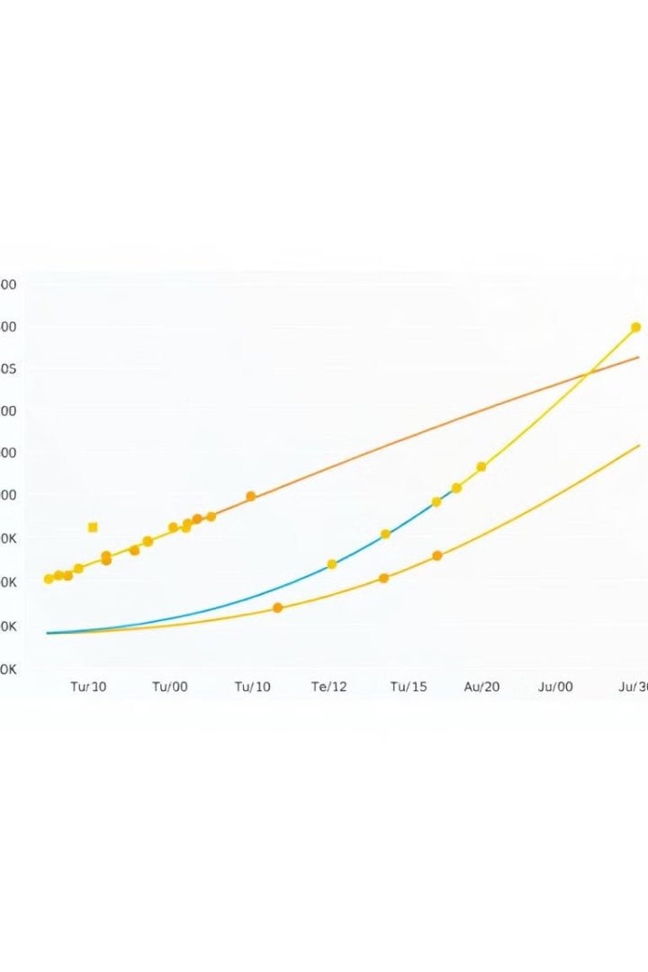
Workload and Tenure Analysis
Number of Projects
Average Monthly Hours
Employees handling 6+ projects showed higher dissatisfaction.
Optimal range: 140–200 hours/month, hours above 250 correlate with higher quit rates.
Time Spent at Company
Risk of quitting peaks at 5 years tenure (likely due to stagnation).

Slide 7
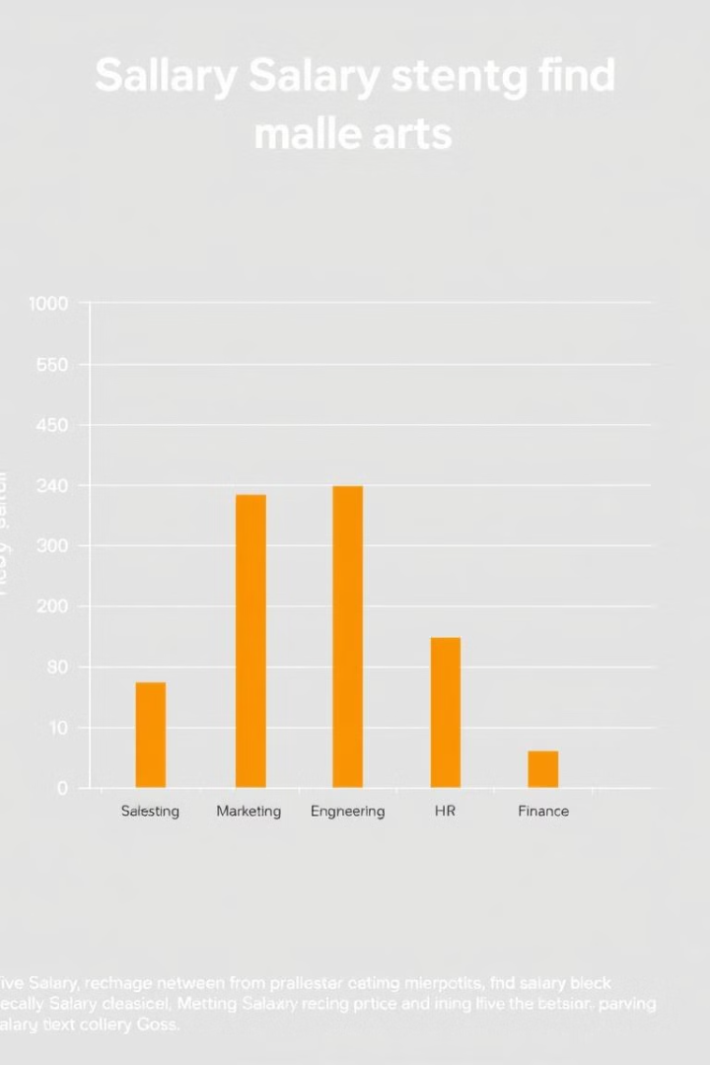


Role of Compensation
Salary Impact
Departmental Salary Trends
Low salary employees have a 35% higher quit rate, high salary provides moderate retention but isn't the sole factor.
Sales and support roles are underpaid compared to others.

Slide 8



Promotions and Accidents
Promotions
Only 2% of employees were promoted in the last 5 years, lack of promotions strongly correlates with dissatisfaction.
Workplace Accidents
Employees with >1 accident have lower satisfaction, though retention isn't directly impacted.

